Slide 1
Fear Factor – A Tactical Model to make money

Slide 2

Searching for an EDGE
Source: 1832 AM LP

Slide 3
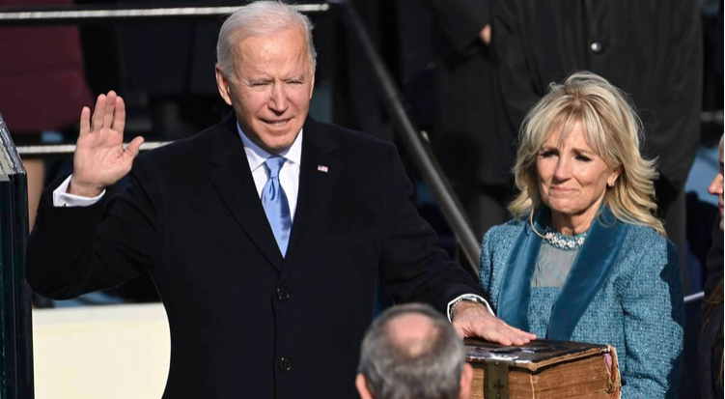
Most Powerful Person in the U.S.
Source: Associated Press

Slide 4

2nd Most Powerful Person in the U.S.
Source: Federal Reserve

Slide 5

DON’T FIGHT THE FED
Source: RBC Capital Markets

Slide 6

GREED IS GOOD
Source: KingWorldNews.com

Slide 7

FEAR IS GOOD – Don’t Fear the Reaper
Source:@NotTheReapor

Slide 8
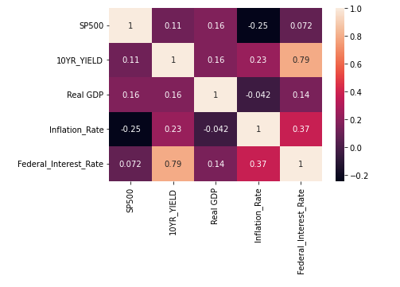
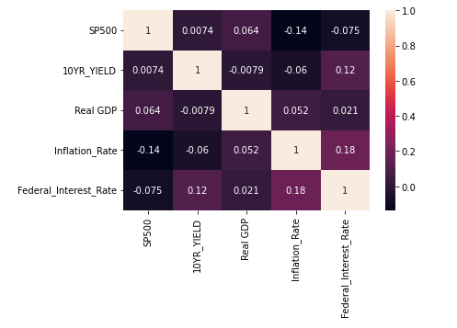
Correlation Pre and Post 2009
Pre-2009
Post-2009

Slide 9
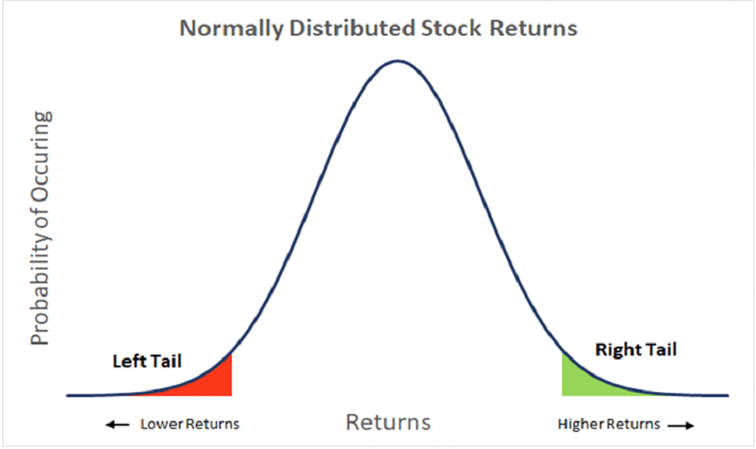
Black Swan Events – Left Tail Risk
Source: Passage Global Capital

Slide 11
Put Strategy (write at VIX 20 or below; buy at 30)

Slide 12
Summary
1) Hypothesis: Fed not as strong (impactful) on market as we thought
2) Sub-hypothesis: The 3 macro factors do not have a major impact on stock market – pre or post 2009.
3) Pivot: VIX strategy, while not perfect, is useful in establishing exit and entry points in the market.

